Slide 1
NAAN MUDHALVAN DATASCIENCE FUNDAMENTAL PROJECT
PROJECT TITLE :
ZOMATO DATA ANALYSIS USING PYTHON
PRESENTED BY:
ANDISAMY N
SACS M.A.V.M.M.ENGINEERING COLLEGE
III YEAR EEE DEPARTMENT

Slide 2
INTRODUCTION
Zomato is a leading online food delivery and restaurant discovery platform headquartered in India. Founded in 2008 by Deepinder Goyal and Pankaj Chaddah, Zomato has grown into one of the largest food technology companies globally, operating in numerous countries and serving millions of users.
We analyzed the best restaurants for each cuisine to provide the data you need. This means you can find out what part of the country has the most restaurants for your desired cuisine, then check out those places and provide a review of all the local places.

Slide 3
PROJECT STATEMENT
The food industry is dynamic, with trends shifting rapidly due to changing consumer preferences, economic factors, and cultural influences. Restaurant owners, investors, and food enthusiasts rely on platforms like Zomato for insights into emerging trends, popular cuisines, and customer sentiments. However, navigating through vast amounts of data on Zomato can be overwhelming. Thus, the problem at hand is to leverage Python for in-depth analysis of Zomato data to extract actionable insights and trends that can inform decision-making processes within the food industry.

Slide 4
PROJECT SOLUTION
The project solution involves leveraging Python for Zomato data analysis. Utilizing Zomato's API, comprehensive restaurant data is collected, cleaned, and analyzed. Key insights on popular cuisines, geographic preferences, and customer sentiments are extracted through exploratory data analysis and sentiment analysis. Actionable recommendations are provided based on analysis findings.

Slide 5
SYSTEM APPROACH
Python and its following libraries are used to analyze Zomato data.
Numpy– With Numpy arrays, complex computations are executed quickly, and large calculations are handled efficiently.
Matplotlib– It has a wide range of features for creating high-quality plots, charts, histograms, scatter plots, and more.
Pandas– The library simplifies the loading of data frames into 2D arrays and provides functions for performing multiple analysis tasks in a single operation.
Seaborn– It offers a high-level interface for creating visually appealing and informative statistical graphics.

Slide 6
ALGORITHMS & DEPLOYMENT
Data Collection:
Retrieve comprehensive restaurant data from Zomato's API, encompassing attributes such as name, location, cuisines, ratings, reviews, and more.
Data Cleaning and Preprocessing:
Prepare the collected data by addressing issues like missing values, duplicates, inconsistent formatting, and outliers to ensure its reliability and usability for analysis.
Exploratory Data Analysis (EDA):
Explore the dataset through statistical summaries, visualizations, and correlation analyses to uncover trends, patterns, and relationships among variables.
Cuisines and Restaurant Preferences:
Identify the most popular cuisines, highest-rated restaurants, and factors influencing customer preferences based on analysis.

Slide 7
ALGORITHMS & DEPLOYMENT
Geographic Analysis:
Visualize restaurant distribution on maps to understand geographic preferences and trends.
Analyze restaurant density, ratings, and customer engagement across different regions or neighborhoods.
Sentiment Analysis:
Implement sentiment analysis techniques to extract insights from user reviews.
Analyze customer sentiments towards various restaurants, cuisines, and dining experiences.
Identify common themes, positive/negative sentiments, and areas for improvement based on user feedback.
Predictive Modeling :
Develop machine learning models, such as regression or classification algorithms, to predict restaurant ratings or customer preferences.
Train models using historical data and evaluate their performance using metrics like RMSE (Root Mean Squared Error) or accuracy.

Slide 8
ALGORITHMS & DEPLOYMENT
Location Analysis: Investigate the distribution of restaurants across different locations. Analyze restaurant density, ratings, and user preferences by geographical area.
Ratings Analysis: Examine the distribution of restaurant ratings and factors influencing high and low ratings. Identify correlations between ratings and other variables such as cuisine type, location, etc.
User Preferences: Analyze user preferences based on reviews and ratings. Extract insights into common themes, sentiments, and factors influencing user choices when selecting restaurants.
Visualization and Reporting: Visualize key findings and insights using charts, graphs, and maps. Prepare a comprehensive report or presentation summarizing the analysis process, results, and actionable recommendations.

Slide 9
CONCLUSION
we aim to uncover valuable insights from Zomato's restaurant data using Python. By analyzing factors such as cuisine popularity, location preferences, and user ratings, we can gain a deeper understanding of consumer behavior and trends in the food industry. Ultimately, this analysis can help businesses make informed decisions and enhance the dining experience for customers.

Slide 10
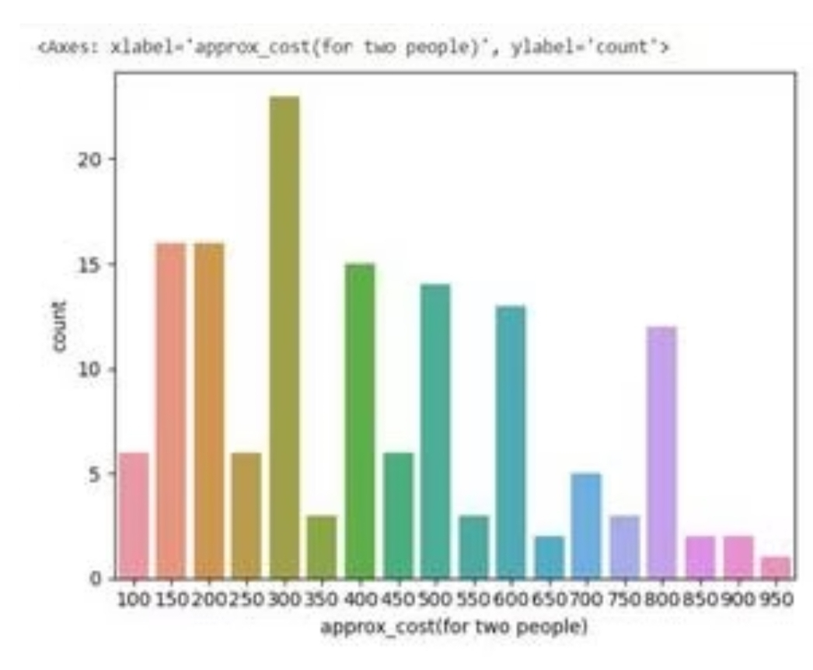
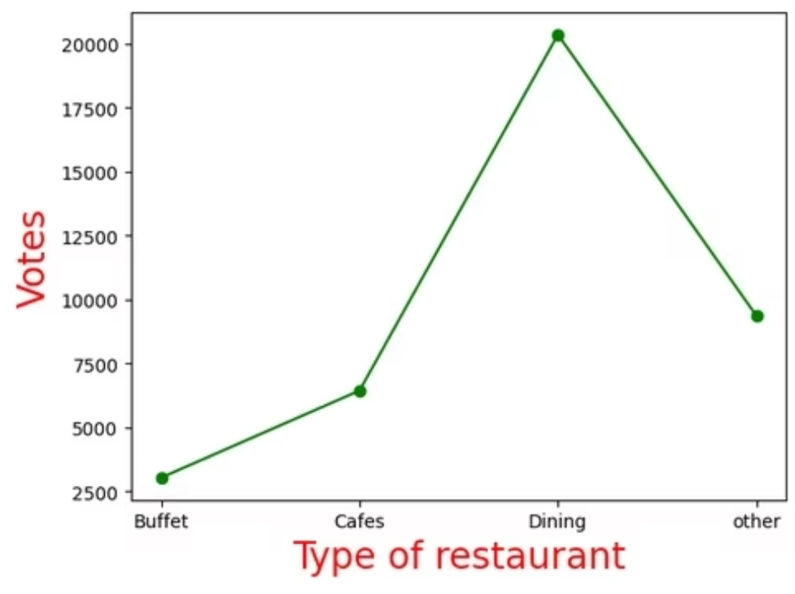
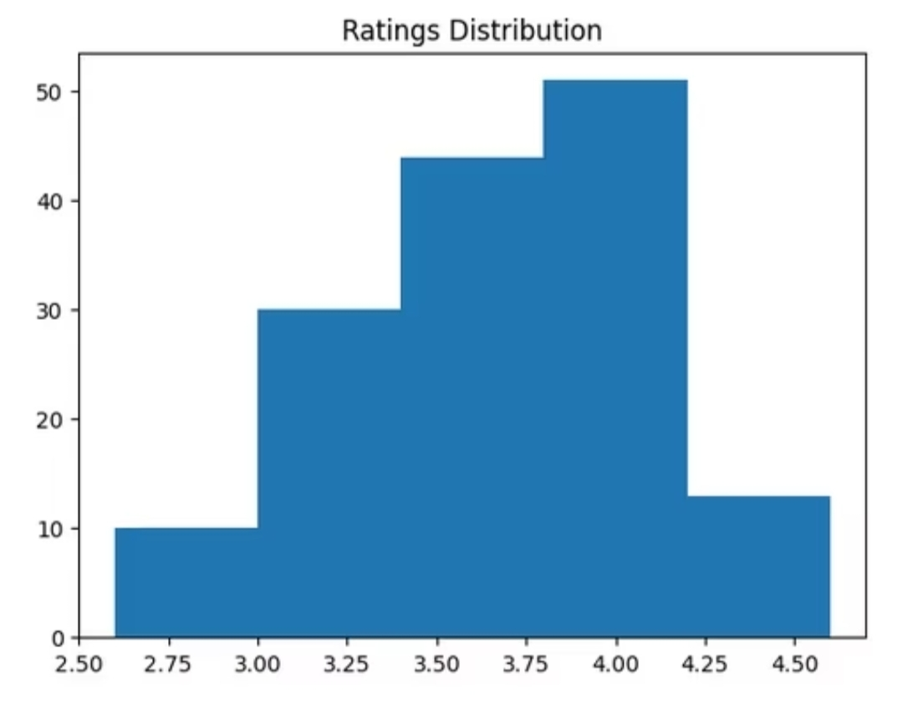
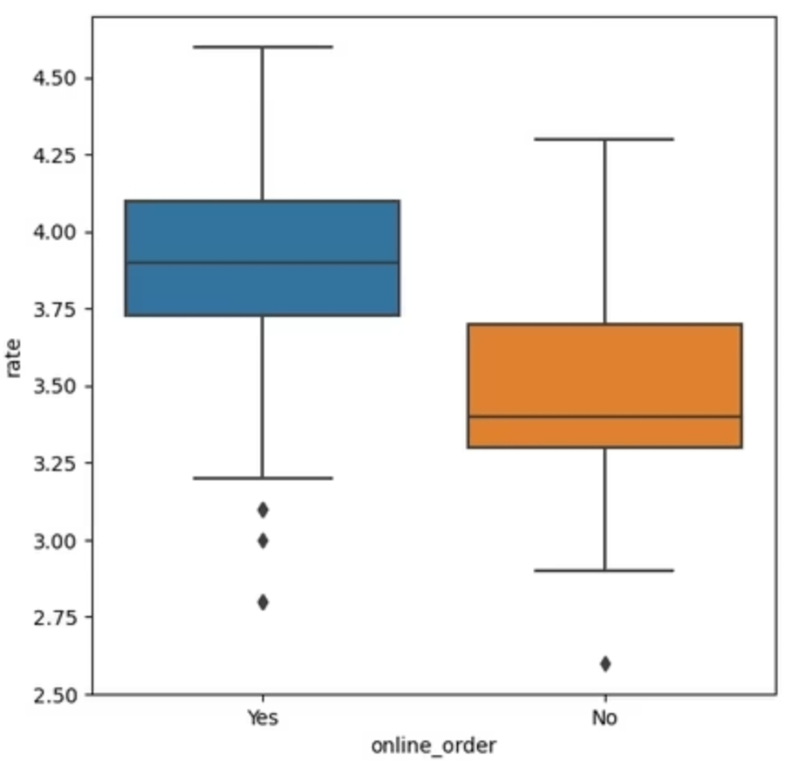
RESULT

Slide 11
REFERENCES
https://www.geeksforgeeks.org/zomato-data-analysis-using-python
https://github.com/topics/zomato-data-analysis
https://www.kaggle.com/code/chirag9073/zomato-restaurants-analysis-and-prediction
https://www.nomidl.com/python/zomato-data-analysis-project-using-python/

Slide 12
Thank you!!

